Slide 1

B.Tech Project External Evaluation, VIIIth Sem Image Super-Resolution Using GAN
Presented by :-
Darshan Parekh, 2018013147
Ankita Maiti, 2018010641
Under the Supervision of:-
Dr. Vishal Jain
Sharda University, Gr. Noida
DEPARTMENT OF COMPUTER SCIENCE & ENGINEERING
SCHOOL OF ENGINEERING AND TECHNOLOGY
May, 2022
1

Slide 2
Contents:
Workload Distribution
Project Overview
Approach
Flowchart
Literature Survey
Detailed Design
Result
Output
Conclusion
Future Scope

Slide 3
Workload distribution of the team
Group Member | Responsibilities
Ankita Maiti | GAN Model, Documentation
Darshan Parekh | GAN Model, Documentation

Slide 4
Project overview:
Reconstructing low-resolution images to high-resolution images by building a neural network is quite challenging but can be used in medical imaging, public surveillance, or old photo recovery applications.
Compared to previous methods, deep learning has a breakthrough in high-resolution accuracy and speed.
By applying a deep network with Generative Adversarial Networks, this model aims to enhance low-resolution images to produce high-resolution images.
The major focus is to reconstruct the image with high resolution by developing the image with low resolution to preserve the main details in the reconstructed images.

Slide 5
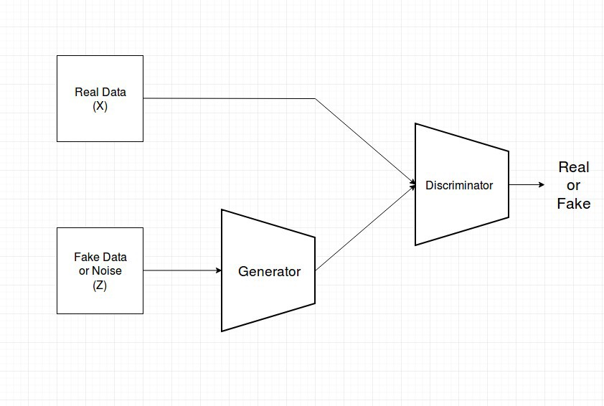
Approach
Generative adversarial networks (GANs)
It is an algorithmic architecture that uses two neural networks, pitting one against the other in order to generate new, synthetic instances of data that can pass for real data.
The two neural networks are the generator and the discriminator. The generator tries to produce a new data instance and the discriminator tries to distinguish whether the data belongs to the training data set or not.
Fig 1. GAN Model

Slide 6
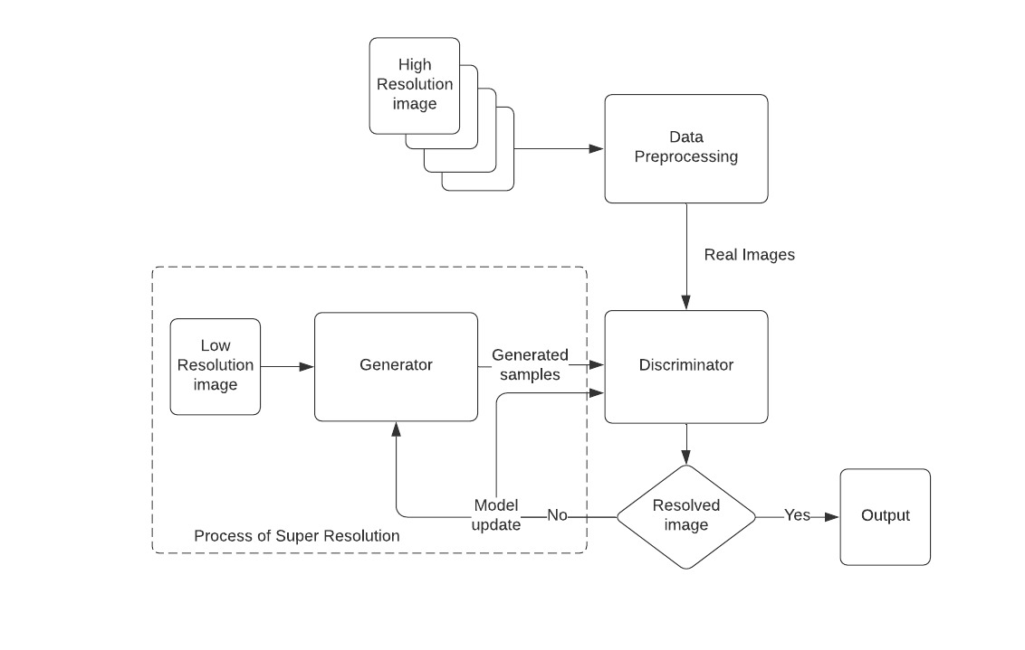
Flowchart
Fig 2. Flowchart

Slide 7
Workload distribution of the team
Group Member | Responsibilities
Ankita Maiti | GAN Model, Documentation
Darshan Parekh | GAN Model, Documentation

Slide 8
Literature Survey
Method | Description | Dataset Used
 |  | Training Dataset | Testing Dataset
Super-resolution generative adversarial network (SRGAN) using ResNet | This network can generate photo-realistic images by upscaling factor × 4 using the deep residual network. | Set5, Set14, BSD100 | BSD300
Gradient Map GAN (GMCAN) | It generates images about HVS (Human Vision system) to design a loss function by combining Image quality Assessment. | DF2K (DIVIK + Flickr2K), DF2K + OST (OutdoorSceneTraining), and DIVIK. | Set5, Set14, BSD100 and Urban100
GAN | It focuses on training two models the evaluating generative models by an adversarial process. | MNIST, the Toronto Face Database (TFD), and CIFAR-10. | MNIST, the Toronto Face Database (TFD)
Coupled GAN (CoGAN) | It is constructed to study the joint distribution in two different domains which include a pair of GANs. | MNIST, Celeb Faces Attributes, RGBD, and NYU dataset
Conditional GAN (CGAN) | Construction of GAN by adding some data to condition on both the generator and discriminator. | MNIST, Flickr, ImageNet, YFCC100M², and MIR Flickr 25000 dataset | MNIST
Super-resolution method with deep CNN | It overcomes the drawback of SRCNN by increasing models network depth and achieving better accuracy. | Berkeley Segmentation Dataset | Set5, Set14, Urban 100, and B100

Slide 9
Super-resolution with a deeply-recursive convolutional network (DRCN) | The super-resolution model with a deep recursive layer improves the overall performance without the need of adding a new parameter. |  | Set 5, Set 14, B100, Urban100
SimGAN | Stimulated and Unsupervised learning where the job is to get familiar with a model to work on the authenticity of a stimulator’s output utilizing unlabeled genuine information while saving the comment data from the stimulator | UnityEyes, NYU hand pose dataset and MPIIGaze | NYU hand pose and MPIIGaze
Style and Structure GAN (S2-GAN) | It includes- the Structure GAN that creates a surface normal map and secondly, the Style GAN which takes input as the surface normal map and creates the 2D image. | NYUv2, SUN RGBD, Places, RGBD, and ImageNet dataset. | NYUv2, SUN RGB-D,
Generative multi-adversarial network (GMAN) | It is a framework for extending GAN to various discriminators to produce higher quality samples in a small number of iterations. | MNIST, CelebA and CIFAR-10
Conditional adversarial network | Image-to-image conversion problem which is effective in synthesizing pictures from label maps, coloring images, and recreating objects. | Cityscape, UT Zappos50K, CMP Facades, Google Maps, and Paris Street View dataset. | UT Zappos50K
Perceptual GAN | It improves detection performance of small through reducing the difference of representation of small objects with the large objects. | Tsinghua-Tencent 100K benchmark and Caltech benchmark | Tsinghua-Tencent 100K benchmark and Caltech benchmark

Slide 10
Stacked GAN | With Conditioning Augmentation to come up with 256×256 photo-realistic images constrained on text representation. | CUB, Oxford-102, and MS COCO | CUB and Oxford-102
Energy-based GAN (EBGAN) | It consists of two method- GANs and auto-encoders in which the discriminator act as the energy function that allocates the low energy to the area around the data while the high energy goes to the remaining areas. | MNIST, ImageNet, LSUN bedroom, and CelebA
GAN | With techniques like Feature matching, historical averaging, minibatch discrimination virtual batch normalization, and one-sided label smoothing to improve the convergence of the GANs | MNIST, CIFAR-10, ImageNet and SVHN

Slide 11
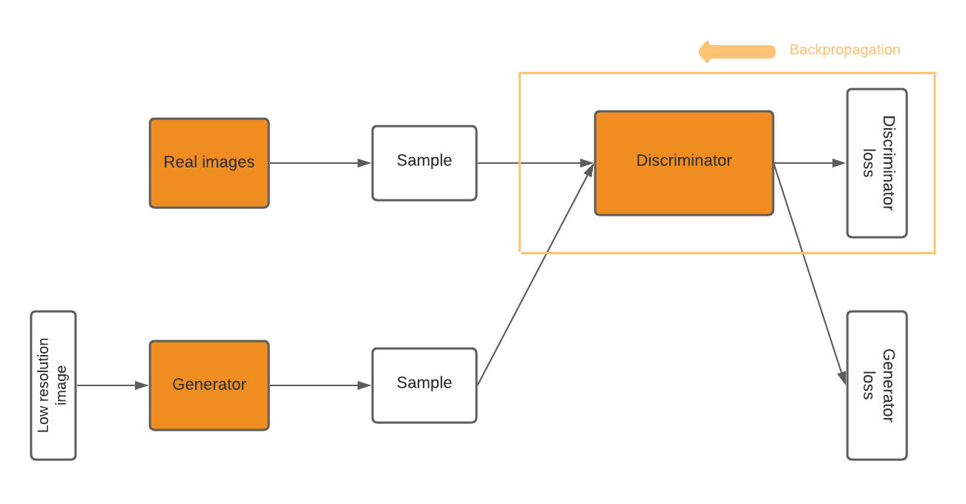
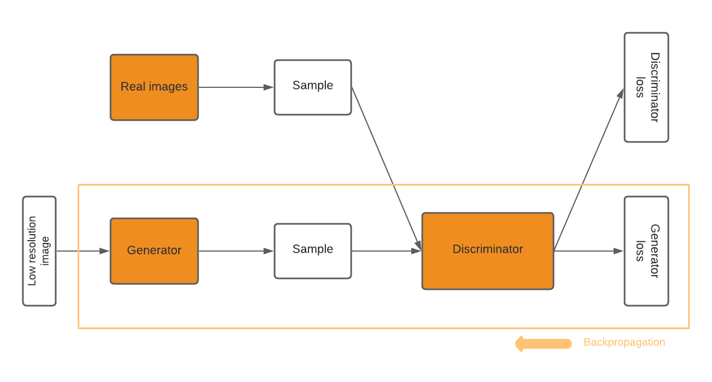
Detailed Design
Our model comprises 5 main components that include:
1. Adversarial network architecture
i. Generator ii. Discriminator
Fig 4.1 Training of Generator
Fig 4.2 Training of Discriminator
2. Perceptual Loss
The loss function examines the solutions associated with related characteristics.
It is the weighted sum of both perceptual loss and adversarial loss.

Slide 12
3. Content loss
This loss function determines VGG loss which is the Euclidean distance between the feature representations of a reconstructed image and the reference image.
4. Adversarial loss
The loss function is based on the probabilities of the discriminator’s overall training samples.
5. Structural Similarity Metric
To perform comparative analysis quality between two images relies on estimated errors between truth image and super resolute image.
The Structural Similarity Metric calculation is based on three factors:
Luminance
Contrast
Structure

Slide 13
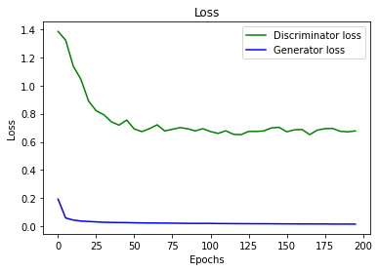
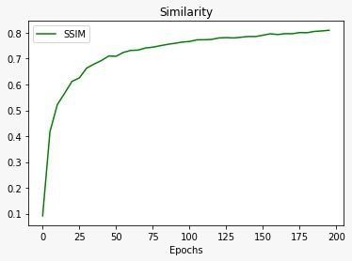
Result
Fig 5.1 Graphical representation of Discriminator and Generator loss
Fig 5.2 Graphical representation of Structural Similarity Index Measure

Slide 14
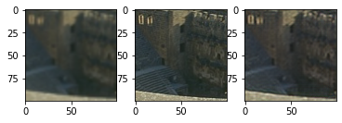
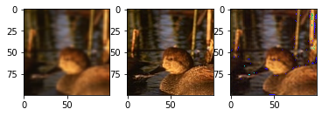
Output
Where,
LR = Low Resolute Image
HR = High Resolute Image
SR = Super Resolute Image
LR image
HR image
SR image
LR image
HR image
SR image

Slide 15
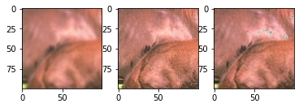
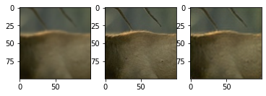
Where,
LR = Low Resolute Image
HR = High Resolute Image
SR = Super Resolute Image
LR image
HR image
SR image
LR image
HR image
SR image

Slide 16
Conclusion
In this research, the authors tried to compare the existing algorithm SRCNN with SRGANs by using publicly available methods as mentioned in the proposed method section which amplifies the adversarial loss and content loss by training GANs and further experimented with our SR images with SSIM measures.
The main aim of this model is to improve the quality of images with super-resolution rather than computational efficiency.
We found that deeper SRGAN models are challenging to train due to the display of different objects.
We also found that the GAN model focuses on texture details, which is a major contrast between super-resolved images generated by SRGAN and those generated by SRCNN.

Slide 17
Future Scope
To improve our model even further, we can introduce the addition of extra training data which in most cases have shown to increase accuracy.
Further improvements can also be made by adding other popular datasets and combining them, adding custom data and tuning hyperparameters.
The developers of this project eventually wanted to add real-life use case for this architecture but for now model is purely for research purpose.

Slide 18
THANK YOU

